Slide 1
iSKKUBot
RAG-based Multilingual Chatbot for Exchange Students at SKKU

Slide 2

EQUIPO SASHIMI
GeonWoo Bang
JungYoon Hwang
Jiae Choi
Mikel Larrarte Rodriguez

Slide 3
Table of Contents
1
Motivation & Objective
4
Demo
2
Progress & role
5
Evaluation
3
Method
6
Limitation
3.1
Indexing
3.2
Rag
3.3
Front-end
3.4
Back-end

Slide 4
Motivation & Objective
1
Brief recap of our motivation and objective

Slide 5
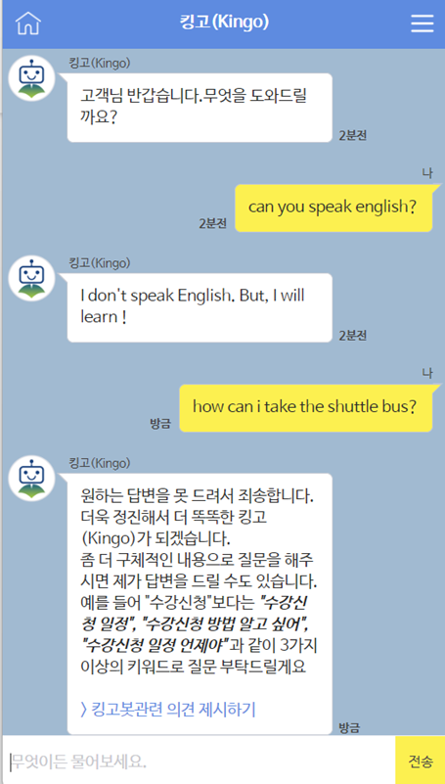
1.1 Motivation
Hard to get relevant information about our school
Language barrier
Fragmented resource
Limitation of Existing chatbot
Monolingual
Keyword-based search
Notes:
Our main motivation is that it is challenging for the International students to get relevant information about our school, Due to the 1) language barrier, and 2) fragmented resource
Limitation of existing chatbot is that it only works with korean, and has limited diversity of questions due to the keyword-based search.

Slide 6
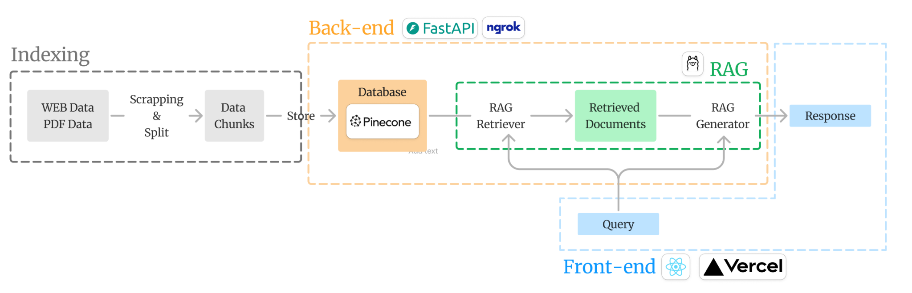
1.2 Objective
Let’s develop RAG based chat-bot that is capable of:
Korean and English
Diverse queries
Notes:
how much of tuition fee can I get for the merit-base scholarship based on average GPA?
https://iskkubot.vercel.app/

Slide 7
Progress & Role
2
What we have done & role assignment

Slide 8
2.1 Timeline
 | Week 6 | Week 7 | Week 8 | Week 9 | Week 10 | Week 11 | Week 12 | Week 13 | Week 14 | Week 15
Scrap form Web/PDF |  |  |  | done
Construct Database |  |  |  | done
Implement RAG(Retriever) |  |  |  | done
Implement RAG(Generator) |  |  |  | done
Evaluate |  |  |  |  |  |  |  |  |  | done
Implement Back-end |  |  |  |  |  |  |  |  |  | done
Implement Front-end |  |  |  |  |  |  |  |  |  | done
Notes:
Mostly progress were on schedule as we expected

Slide 9
2.2 Role
Geon Woo RAG, back-end
Jiae Indexing, front-end
Jung Yoon(Team Leader) Managing overall flow, Indexing
Mikel Evaluation

Slide 10
Method
3
Final implementation of our project

Slide 11


3.1 Indexing
Dataset
Office of International Student Services, Sungkyunkwan University Webpage data(introduction, immigration guided, campus life, academics, etc)
Today’s School restaurant menu
2024 SKKU club guide book
International Student Handbook

Slide 12

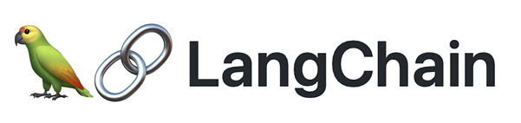
3.1 Indexing
Implementation
Web: BeautifulSoup
PDF: PyPDFLoader from langchain

Slide 13
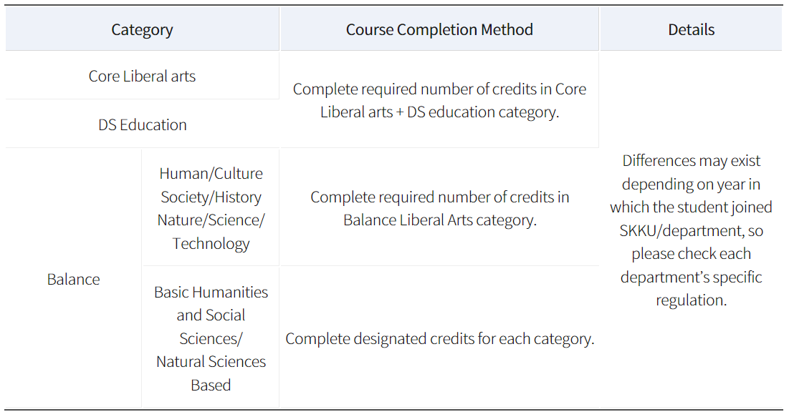
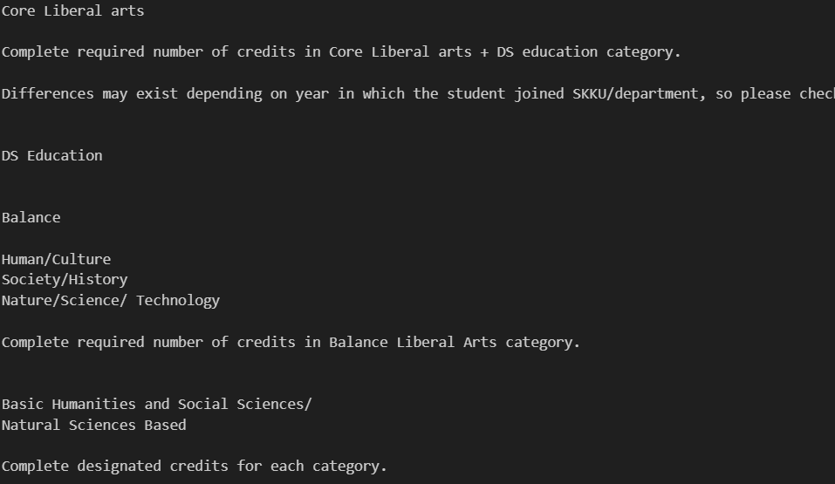
3.1 Indexing
Challenges: Tabular data
Tabular data was converted into plain texts, losing its structure

Slide 14
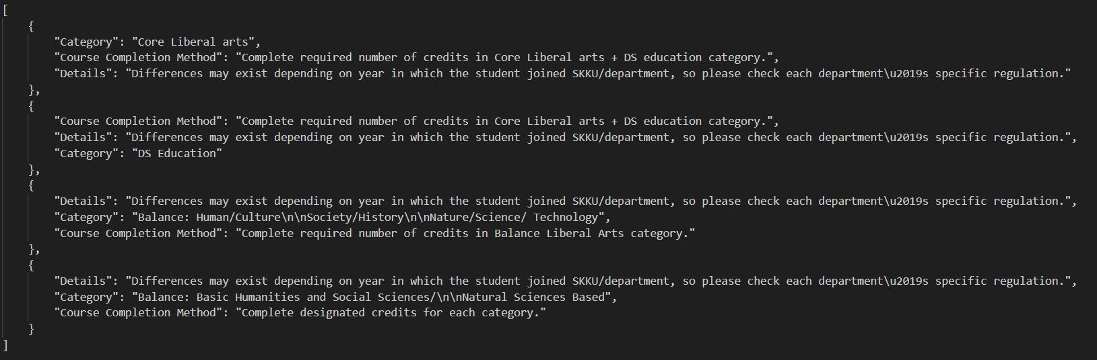
3.1 Indexing
Challenges: Tabular data
Web: custom python code
PDF: pdfplumber(kor), unstructured API(eng)
Notes:
To handle tabular data, we converted it into json format or dataframe.
For web, we developed a custom python code because existing libraries were not able to convert tables with multiple spans of rows and columns.
For pdf, we used unstructuredAPI, which converts tabular data into dataframe.
However, unstructuredAPI was not able to handle korean, and we used pdfplumber for korean instead.

Slide 15
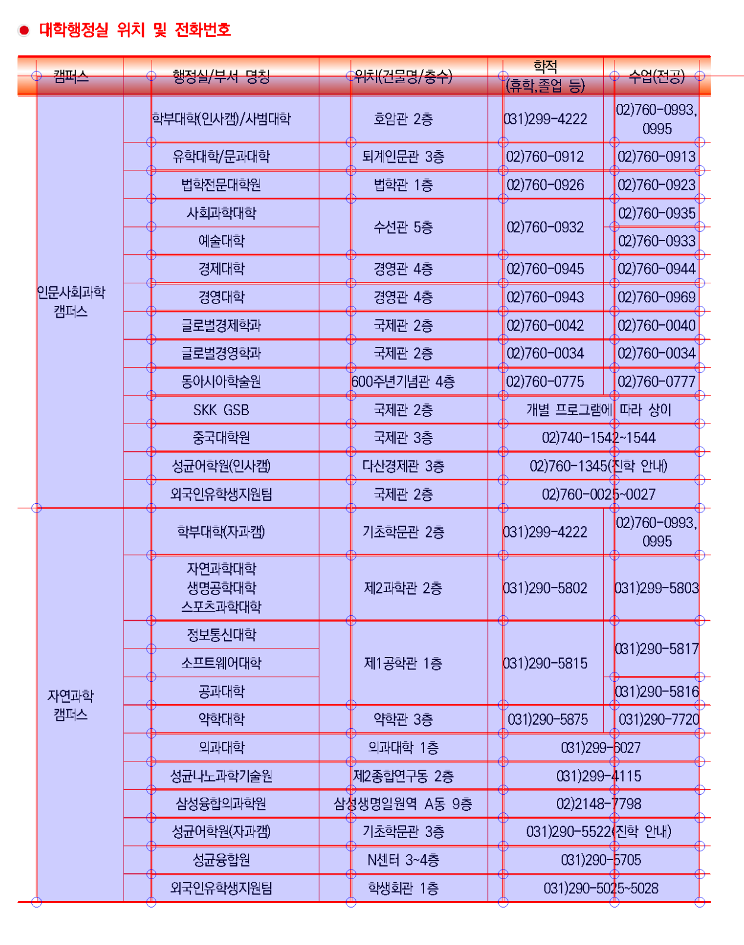
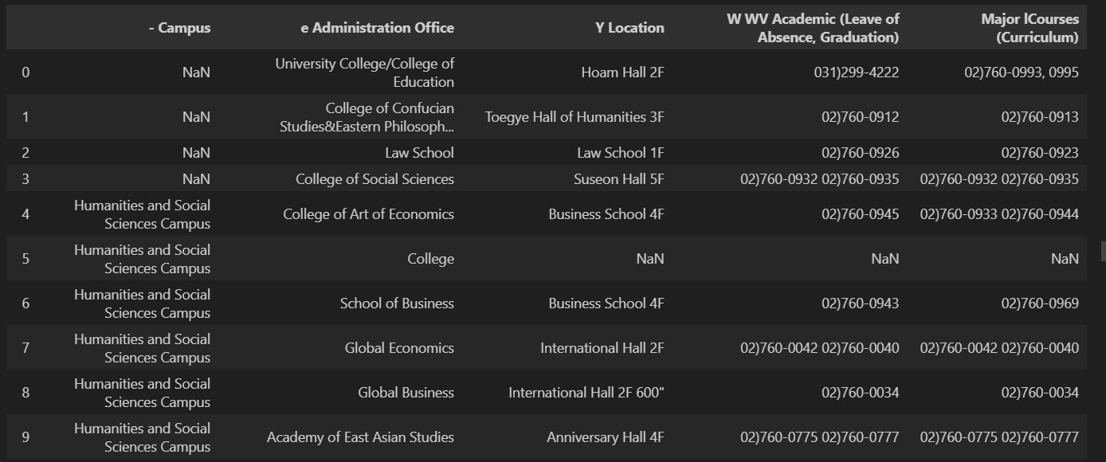
3.1 Indexing
Challenges: Tabular data
Web: custom python code
PDF: pdfplumber(kor), unstructured API(eng)
Notes:
What is the timetable for the reference room in the library?

Slide 16
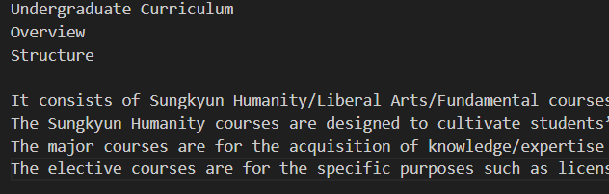
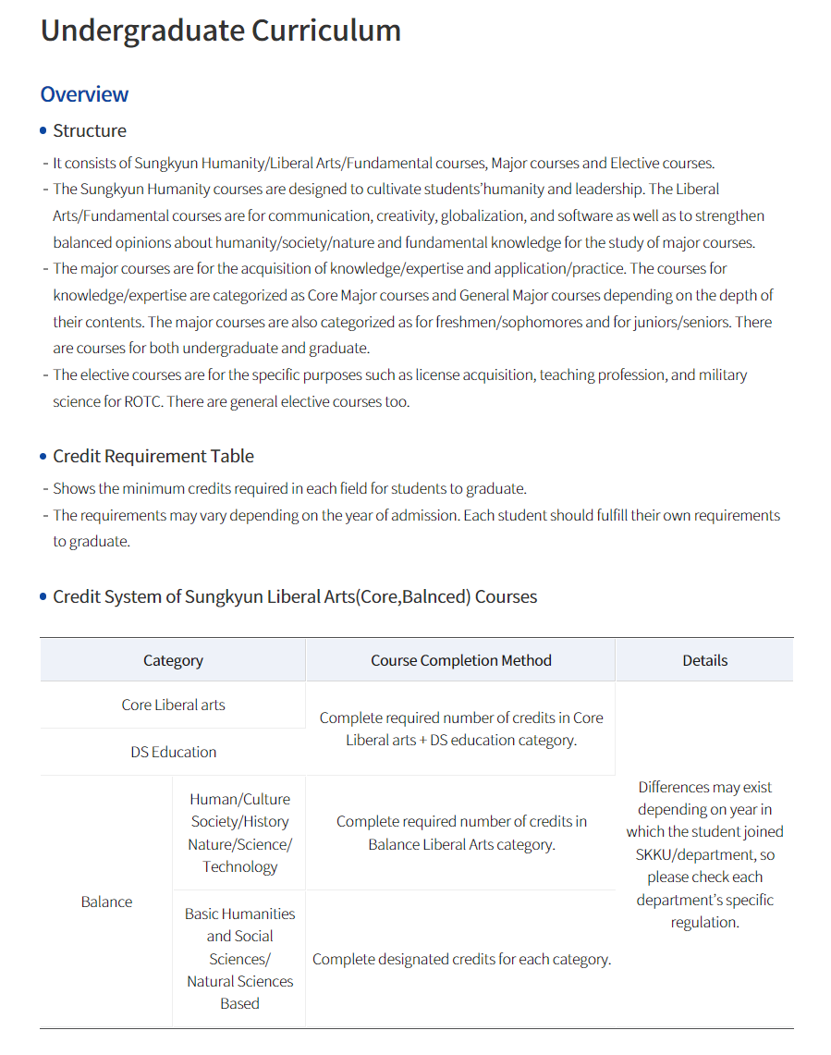
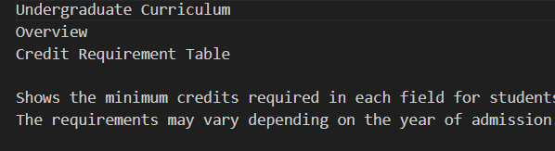
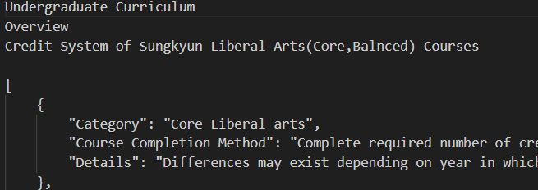
3.1 Indexing
Split
Web: based on header tag
PDF: based on page
Notes:
We also split the scrapped contents into chunks, ensuring that each chunks contains coherent and complete information.
For web we splitted based on header tag,
And for pdf, we splitted based on page.

Slide 17

3.1 Indexing
Pinecone
Vector database
Reason: external server, easy to use, free pricing
Multilingual-E5-Large model
Notes:
Pinecone is a vector database service and we chose it because it has an external server, easy to use, and has free pricing.
Web and PDF chunk data were embedded using the Multilingual E5 Large model and stored in the Pinecone database.
Since the recommended configuration for Multilingual E5 Large model embeddings is a 1024-dimensional vector with cosine similarity, the database was set up accordingly.

Slide 18



3.1 Indexing
Overview of Indexing
Text data
Split
chunks
embedding
Tabular data
embedding
Text data
Split
chunks
Multilingual E5 Large model
Tabular data (kor)
Tabular data (eng)

Slide 19
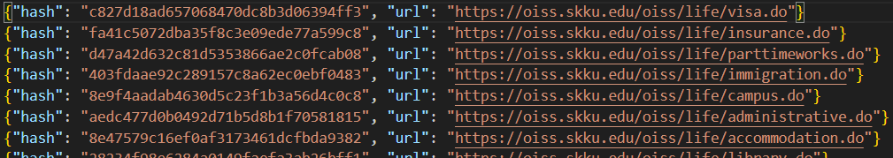
3.1 Indexing
Challenge: Outdated database
Data can be outdated due to the modification of web contents
Update database
Hashed page
Create a hashed version of each webpage.
Identify the modified webpage via difference between current hash and initial hash.
Notes:
What is today's menu for the Haeoreum cafeteria?

Slide 20
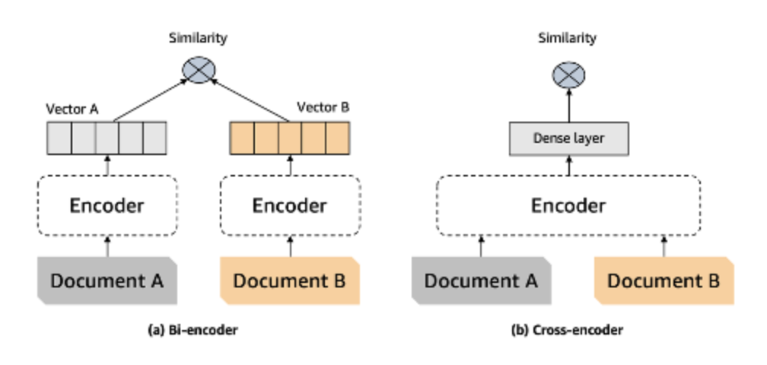

3.2 RAG
Retriever
Ranking Stage
Re-Ranking Stage
Fast, Easy to calculate
Lower performance
Slow, Hard to train
Higher performance
Notes:
RAG is fundamentally divided into two main steps.
The first step is the Retriever. To provide highly reliable information, it is crucial to extract the most relevant context from the database. For this, we have structured the Retriever stage into two stages.
The first stage is the Ranking Stage. In a standard RAG pipeline, a biencoder embedding model is used to calculate the cosine similarity between the user’s query and the contexts. However, biencoders have their pros and cons. While they are faster and computationally efficient compared to crossencoders, their training objective is not primarily designed for similarity comparisons, resulting in inferior performance to crossencoders. Therefore, in our Retriever stage, the biencoder is not used to finalize the context selection. Instead, it identifies a broad pool of candidate contexts.
The second stage is the Reranking Stage. Based on the candidates retrieved in the ranking stage, we use a reranker employing the slower but more accurate crossencoder approach to re-rank the results. From this step, the top-3 final candidates are selected.
The models used in each stage are shown in ppt.
This structured approach ensures a balance between efficiency and accuracy, leveraging the strengths of both biencoders and crossencoders to deliver high-quality results.

Slide 21

3.2 RAG
Retriever
Vector DB
Context 1
Ranked Context
Ranked 1
Reranked Context
Context 2
Context 3
Ranked 2
Final Context 1
Final Context 2
Final Context 3
Context n-1
Ranked 200
Context n
Re-Ranking Stage
Ranking Stage
Notes:
Therefore, our Retriever extracts relevant contexts from the vector database through two stages, narrowing down from 200 candidates to the final 3. Each stage can be thought of as acting like a sieve, progressively filtering the contexts to ensure only the most relevant ones remain.

Slide 22
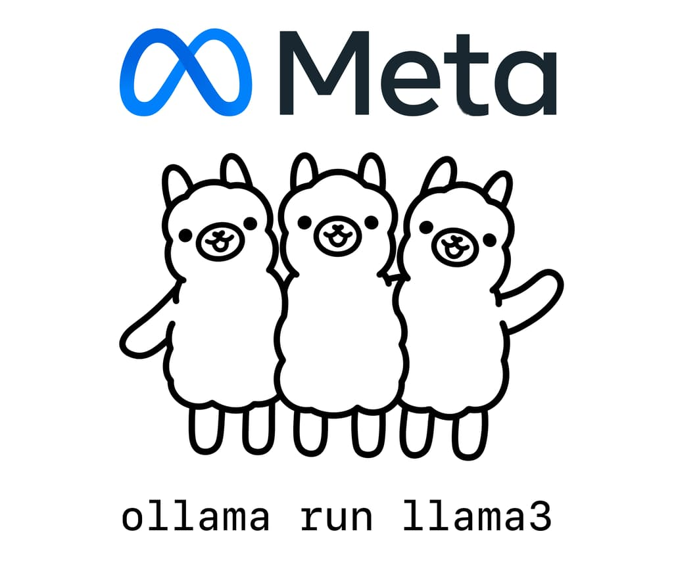
3.2 RAG
Generator (LLM)
Model Selected Reasons
One of the Top model on 7~13B size Korean LLM
Support GGUF format for using Ollama
Well Quantized (Q4_K_M)
Using Ollama to serve EEVE-Korean-Instruct-10.8B model
Notes:
Next is the Generator stage. This is where we select the most suitable LLM for our system. For this purpose, we chose Ollama as the platform to serve our model. Ollama allows us to easily deploy and run the LLM on our server, simplifying the entire process. One of its key advantages is its seamless integration with various Python libraries, which greatly facilitates development, evaluation, and usage.
We selected Yanolja’s eeve-korean-instruct 10.8 billion model as our LLM. This model was chosen because it is one of the highest-performing small-scale LLMs that supports Korean. Moreover, it supports the GGUF format, making it easily compatible with Ollama, and it is well-quantized for efficient deployment.
By integrating this model with our Retriever, we have successfully completed the development of our Generator.

Slide 23



3.3 Front-end
Development
Deployment
Notes:
We chose React and TypeScript for our web development due to their efficiency and strong type safety.
For front-end deployment, we chose Vercel as our platform. It automatically redeploys the project whenever code is pushed to the GitHub repository, making the CI/CD process convenient.

Slide 24
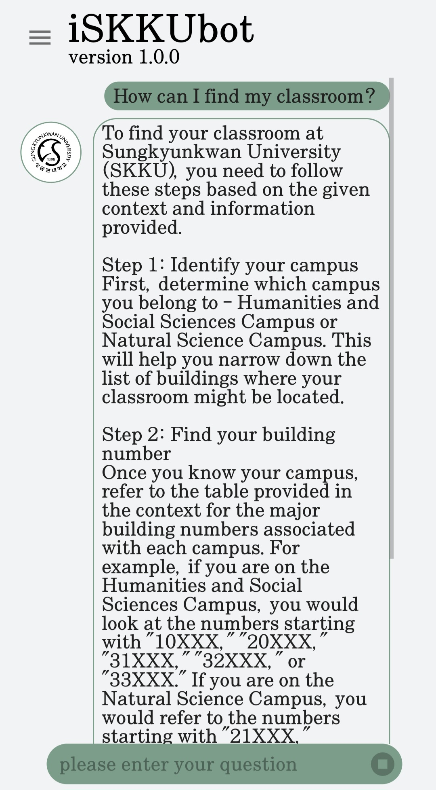

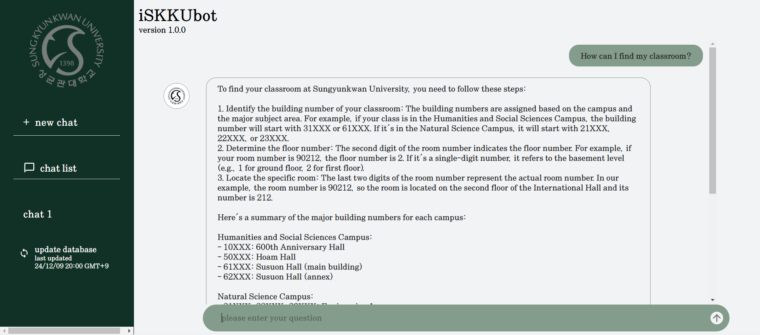
3.3 Front-end
Desktop ver.
Mobile ver.
Notes:
This is the final UX/UI design of our chatbot. Our chatbot is built with a responsive web design, allowing components to adapt to different device sizes. So, users can access it conveniently on any device or browser.

Slide 25



3.4 Back-end
API Framework
Deployment
Notes:
In the backend development phase, we utilized FastAPI as the framework to provide APIs. For deployment, we relied on Uvicorn and Ngrok, ensuring rapid deployment of our services.

Slide 26
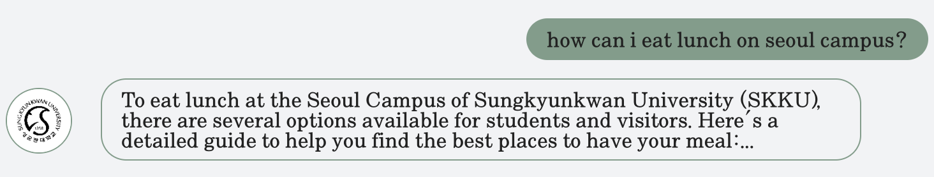


3.4 Back-end
POST: /chat
AUTO/GET: /update_db & GET: /last_update
Updated URL
Pinecone DB
Notes:
This feature is implemented as a POST method endpoint. When a user sends a query, the endpoint returns the output generated by the RAG model. A key highlight of this feature is that it has been designed to operate asynchronously, enhaning the user experience by streamlining the response.
Next are the Update DB and Last Update functionalities.
The Update DB feature is responsible for keeping the database up-to-date. When a GET request is made to this endpoint, update database function is called. Since frequent calls to this function could result in resource wastage, it has been designed specifically for administrator use. Additionally, to ensure regular updates, we have configured a scheduler to automatically trigger this function daily at midnight.
When the Update DB process is executed, the server records the latest update timestamp. The Last Update endpoint, also implemented as a GET method, retrieves and returns this stored timestamp. This timestamp is displayed to users via the front-end, keeping them informed about the most recent database update.

Slide 27
Demo
4
Demo of our project

Slide 28
Iskkubot - demo
https://iskkubot.vercel.app/
how much of tuition fee can I get for the merit-base scholarship based on average GPA?
Can you recommend me some school bands
Table: What is the timetable for the reference room in the library?
Update: What is today's menu for the Haeoreum cafeteria?
Bilingual: 학술정보관에 들어 가려면 뭘 챙겨야 해??
Notes:
What is the timetable for the reference room in the library?
What is today's menu for the Haeoreum cafeteria?
Can you recommend me some school bands
학술정보관에 들어갈려면 뭘 챙겨야 해??
Tell me about the total timestamp for the shuttle bus
what do I need to bring in order to enter the library in Suwon campus?

Slide 29
Evaluation Results
5
Our evaluation results & insights.
Notes:
Now, let’s discuss the obtained evaluation results.

Slide 30
5. 1 LLM Eval
Synthetic Dataset:
Created a synthetic dataset using GPT-4o-mini for context-question-answer pair generation.
Generated 332 pairs, filtered to 288 based on:
Groundedness: Can the question be answered from the given context?
Relevance: Is the question meaningful to users?
Used a critique agent to score and filter pairs systematically.
Notes:
As a reminder for everyone but more specifically for the non AI students, I will summarize the evaluation process we have followed.
To start with, we built a synthetic dataset to evaluate our RAG system. Using GPT-4o-mini, we generated 332 question-answer pairs. However, we applied a rigorous filtering process based on two criteria: groundedness, which ensures the question can be answered from the given context, and relevance, which checks if the question is meaningful to users. After this process, we ended up with a dataset of 288 pairs by scoring and filtering with a critique agent. This set forms the basis of our evaluation.

Slide 31
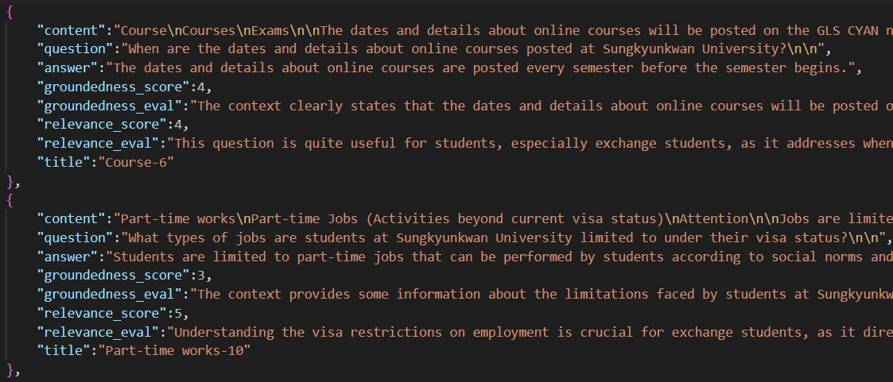
5. 1 LLM Eval
Dataset overview (Context, QA pair):
Notes:
Here are some examples of our evaluation dataset, which contains context, question, and answer pair. And filtered them based on groundedness and relevance.

Slide 32
5. 1 LLM Eval
Evaluation Process:
Judge agent: GPT-4o-mini.
Focused on Faithfulness metric:
Evaluates fidelity of generated answers to context.
Evaluation process:
Detailed feedback on generated responses.
Scoring from 1-5 based on rubrics.
Score 1: Completely incorrect.
Score 5: Completely correct.
Notes:
For the evaluation, we used GPT-4o-mini as our judge agent. The primary metric we chose to assess the system's performance was faithfulness. This metric measures if the generated response is correct, accurate, and factual based on the reference context. The evaluation process included generating detailed feedback for each response and assigning a score between 1 and 5 based on predefined rubrics. For instance, a score of 1 indicates a completely incorrect response, while a score of 5 represents a completely accurate one.

Slide 33
5. 1 LLM Eval
Evaluation Prompt:
EVALUATION_PROMPT = """###Task Description: An instruction (might include an Input inside it), a response to evaluate, a reference context that gets a relevant information, and a score rubric representing a evaluation criteria are given. 1. Write a detailed feedback that assess the quality of the response strictly based on the given score rubric, not evaluating in general. 2. After writing a feedback, write a score that is an integer between 1 and 5. You should refer to the score rubric. 3. The output format should look as follows: \"Feedback: {{write a feedback for criteria}} [RESULT] {{an integer number between 1 and 5}}\" 4. Please do not generate any other opening, closing, and explanations. Be sure to include [RESULT] in your output. ###The instruction to evaluate: {instruction} ###Response to evaluate: {response} ###Reference Context (Score 5): {context} ###Score Rubrics: [Is the response correct, accurate, and factual based on the reference context?] Score 1: The response is completely incorrect, inaccurate, and/or not factual. Score 2: The response is mostly incorrect, inaccurate, and/or not factual. Score 3: The response is somewhat correct, accurate, and/or factual. Score 4: The response is mostly correct, accurate, and factual. Score 5: The response is completely correct, accurate, and factual. ###Feedback:"""
Notes:
To better understand this, here is the evaluation prompt.
We can see that we define the evaluation method just specifying it in the prompt. We also define some score rubrics so the model knows how to grade the answers.
Finally we ask the model to give a feedback based on the rubric to then get a score from 1 to 5.

Slide 34
5. 1 LLM Eval
Evaluation Results & Insights:
Achieved an overall score of 3.50 out of 5.
Main influence of the score: our model provides more information:
Generated questions are only based on single context, but our model searches various informations related to query.
GPT evaluates it as “wrong”, but there is no problem on real usage.
Notes:
After letting the model evaluate the model, we obtained scores for each generated answer. After computing the mean average of all scores, we achieved an overall score of 3.50 out of 5. As we can see, we could say that our RAG system has achieved an acceptable score. After some reflection, we think we could improve this score a little more by tweaking the generation prompt of the RAG system. In fact, we believe the main point that affects the score is the length of our generated answers. Looking at the synthetic answers, the majority of them are quite concise, whereas our answers are lengthy and provide more details. Therefore, as previously mentioned, we could expect this score to easily improve by simply modifying the prompt our RAG system uses to generate answers, explicitly conditioning the model to shorten its output.

Slide 35
5.2 Human eval
Google forms
Does the model answer correctly?
Is the model’s answer useful?
How is the latency of the model?
Does the given source link help increase the reliability of the chatbot's answers?
Any suggestions for our model?
Overall rating of our model

Slide 36
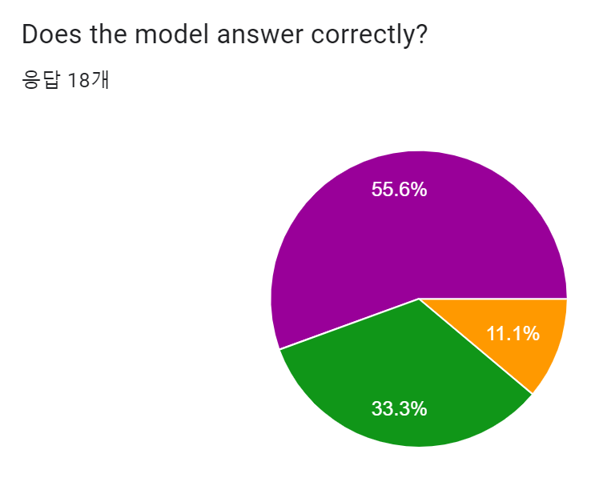
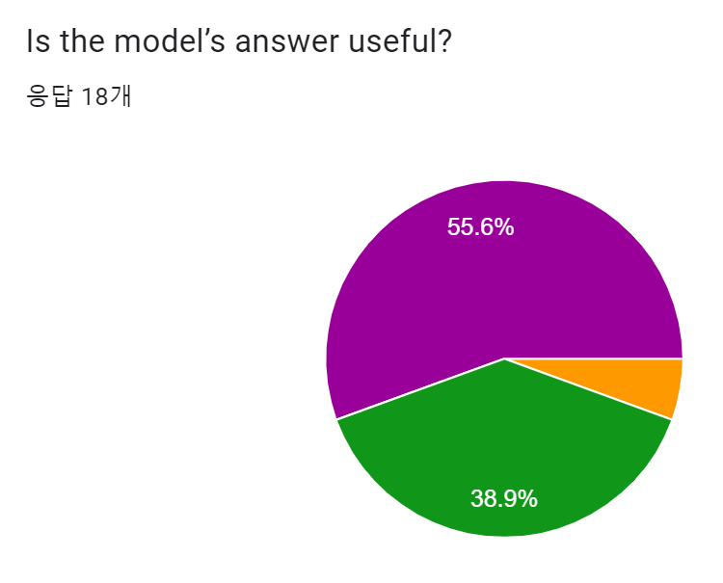
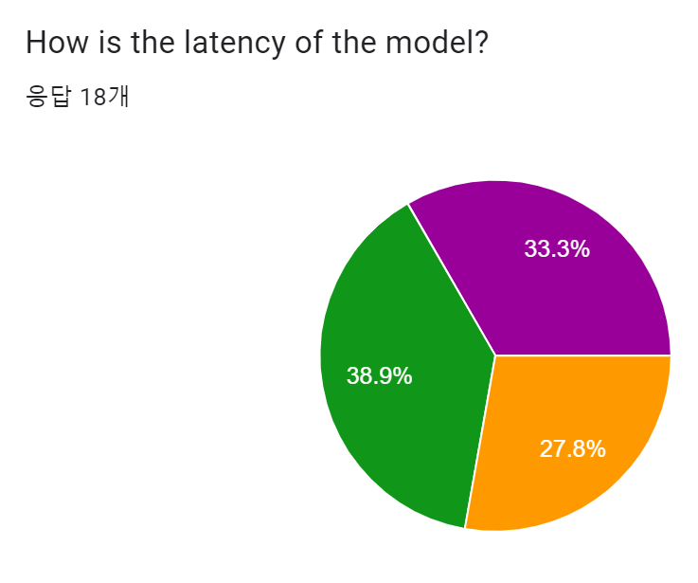
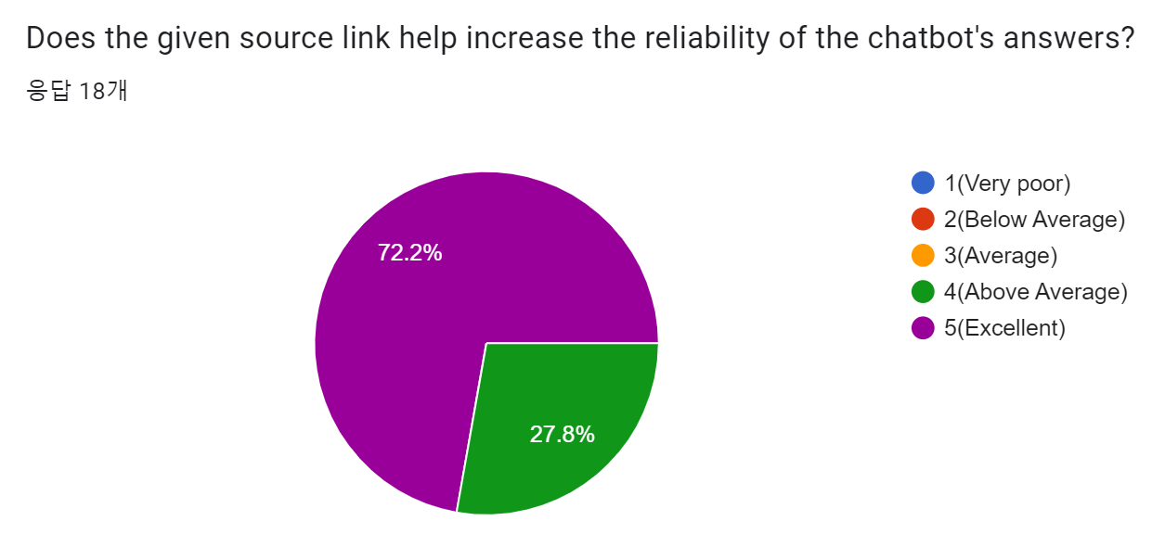
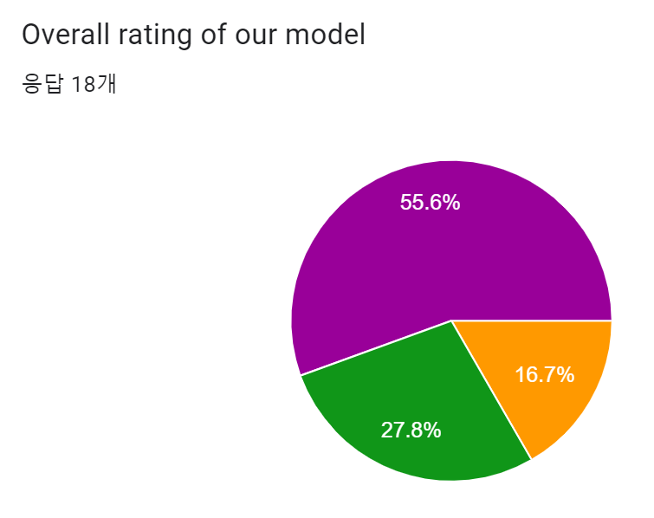
5.2 Human eval
Result
4.45
4.5
4.05
4.72
4.38
Notes:
We got total 18 responses from students in SKKU, and here are the results.

Slide 37
Limitation
6
Limitation of our project

Slide 38
Limitation
Small database
Cannot handle Images
Chat history is not saved per user
Failure in general chat situations

Slide 39
Thank you!
Do you have any questions?

